Slide 1
Emergence of Complexity in Cellular Automata
Angelica Berner

Slide 2
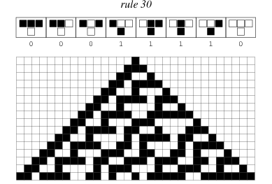
What are Cellular Automata?
Computational model that evolves over time
Cellular Automata can be reversible
They have the ability to demonstrate OEE, which can be used to measure complexity
http://mathworld.wolfram.com/CellularAutomaton.html

Slide 3
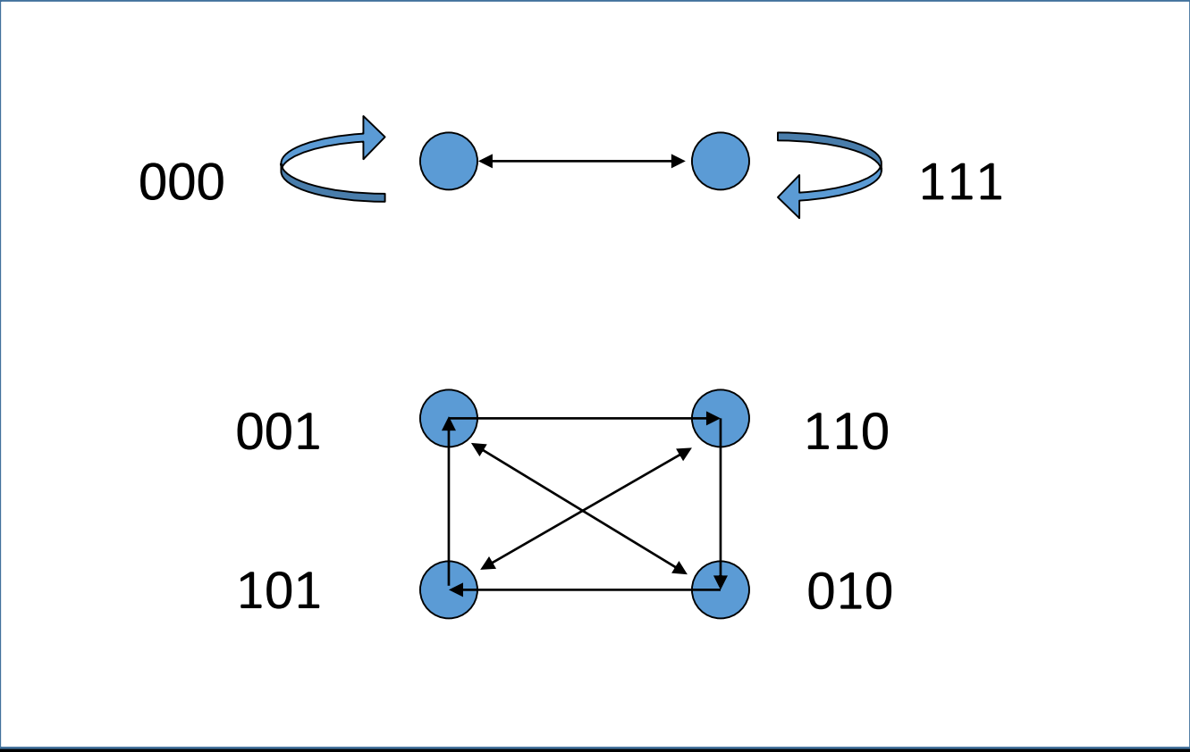
Reversibility

Slide 4
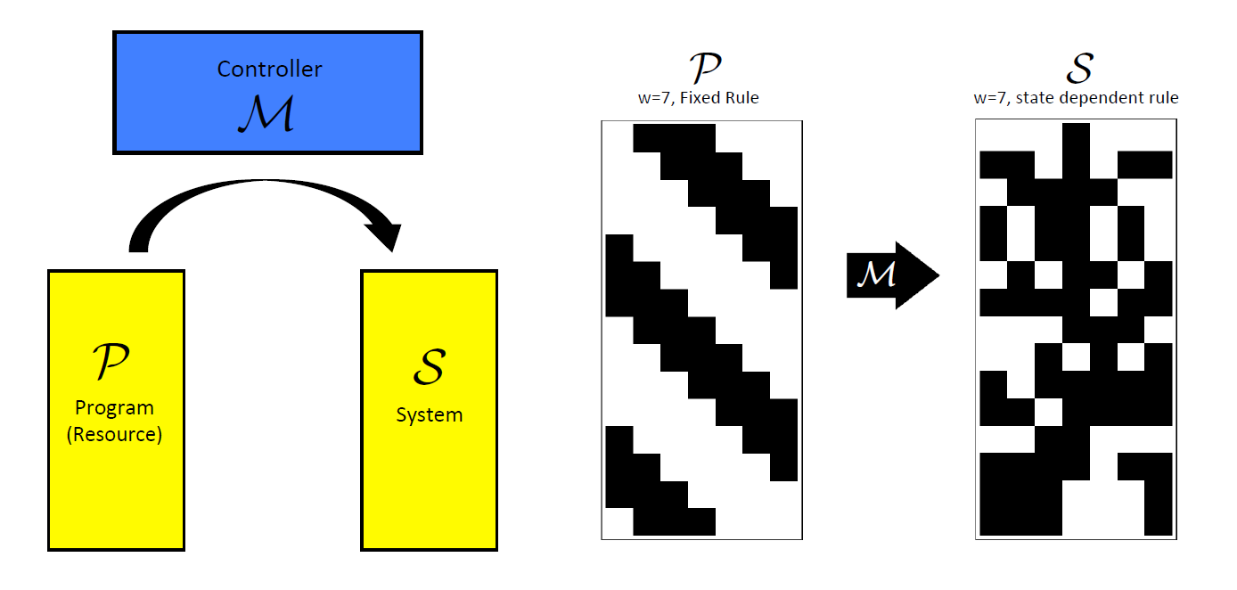
Open Ended Evolution (method)

Slide 5
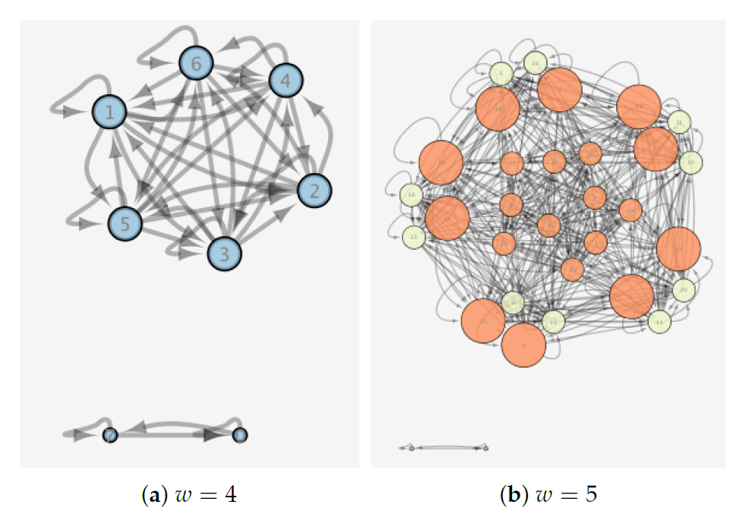
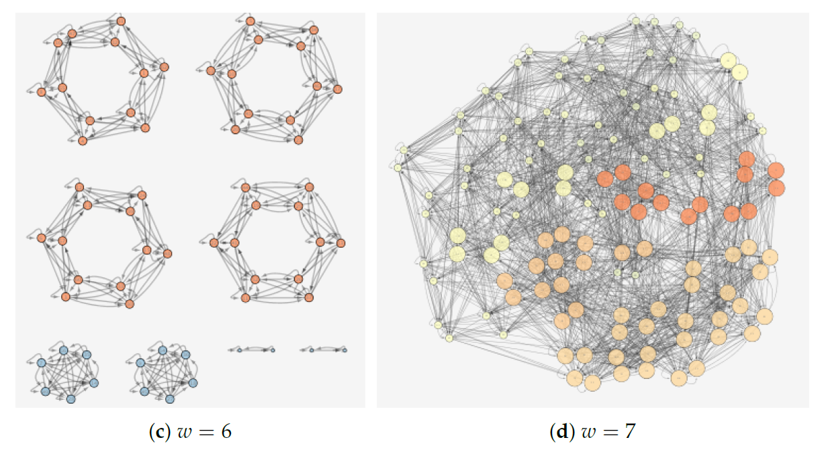
State Transitions (varying w, constant R_{p})

Slide 6
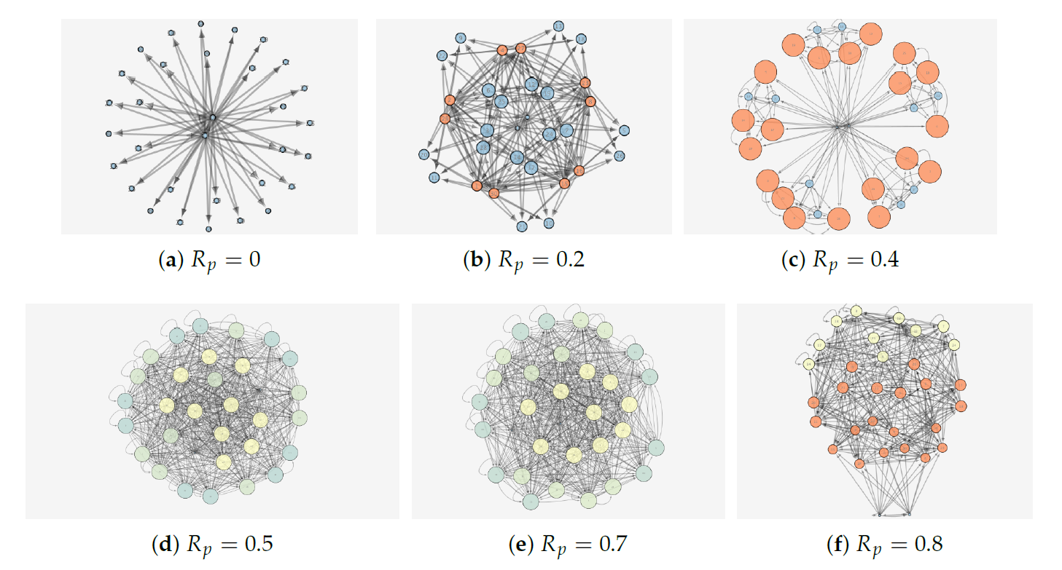
State Transitions (varying R_{p}, constant w)

Slide 7
Revisiting the Model

Slide 8
What We’re Currently Exploring
Is there any relationship between complexity and effective information?
Effective Information:
“Assess the causal influence of one subset of a system on another.” – Hoel, 2016
“When effective information is asses over the entire system, it captures how effective and informative a system’s causal structure is. Used this way, effective information represents a quantification of “deep understanding”.” – Hoel, 2016, Pearl, 200.

Slide 9
Acknowledgements
My sincerest gratitude goes to
Sara I. Walker, Alyssa Adams, Paul Davies
NASA Space Grant
ASU, The School of Earth and Space Exploration

